Slide 1
Trigonometric Functions of Any Angle
4.4
Copyright © Cengage Learning. All rights reserved.

Slide 2
What You Should Learn
Evaluate trigonometric functions of any angle
Find reference angles
Evaluate trigonometric functions of real numbers

Slide 3
Introduction

Slide 4
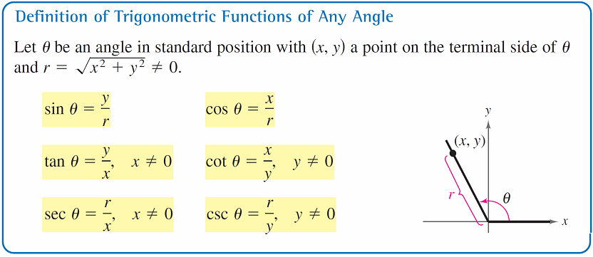
Introduction
Following is the definition of trigonometric functions of Any Angle. This applies when the radius is not one (not a unit circle).

Slide 5
Introduction
Note: when x = 0, the tangent and secant of θ are undefined.
For example, the tangent of 90 ° is undefined since the sine of 90 ° is 1 and the cosine of 90 ° is 0. 1/0 is undefined.
Similarly, when y = 0, the cotangent and cosecant of θ are undefined.

Slide 6
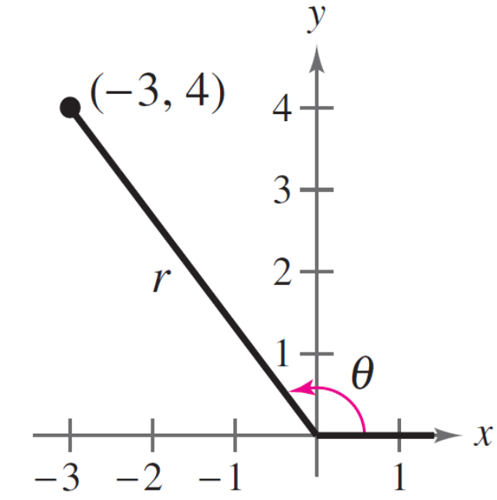
Example 1 – Evaluating Trigonometric Functions
Let (–3, 4) be a point on the terminal side of θ
(see Figure 4.34).
Find the sine, cosine, and tangent of θ.
Figure 4.34

Slide 7
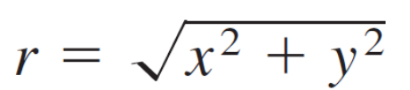



Example 1 – Solution
Referring to Figure 4.34, you can see by using the Pythagorean Theorem and the given point that x = –3, y = 4, and

Slide 8
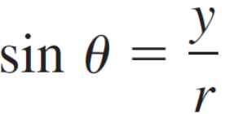
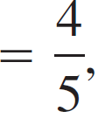
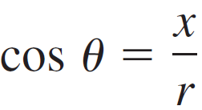
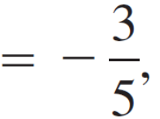
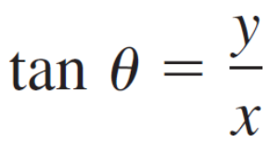
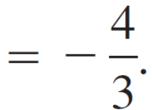
Example 1 – Solution
cont’d
So, you have
and

Slide 9
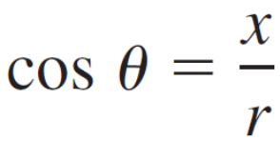
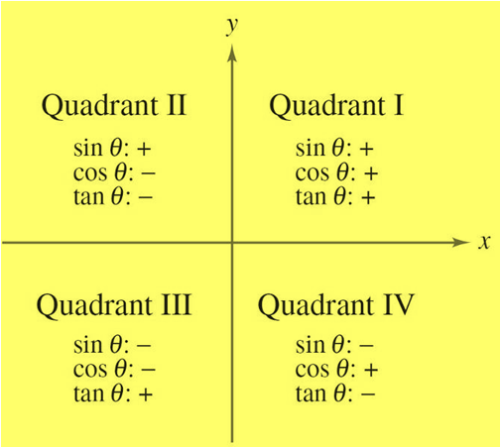
Introduction
The signs of the trigonometric functions in the four quadrants can be determined easily from the definitions of the functions. For instance, because
it follows that cos θ is positive
wherever x > 0, which is in
Quadrants I and IV.
We will discuss “All Students
Take Calculus” in class as a way
to help us remember this.

Slide 10
Reference Angles

Slide 11
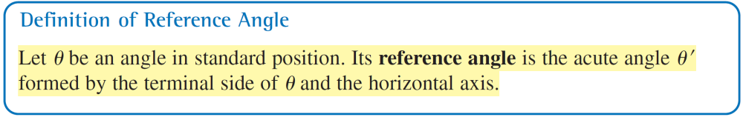
Reference Angles
The values of the trigonometric functions of angles greater than 90 ° (or less than 0 °) can be determined from their values at corresponding acute angles called reference angles.

Slide 12
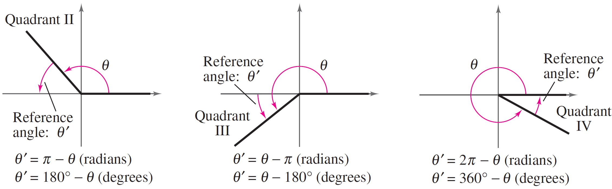
Reference Angles
Figure 4.37 shows the reference angles for θ in Quadrants II, III, and IV.
Figure 4.37

Slide 13
Example 4 – Finding Reference Angles
Find the reference angle θ ′.
a. θ = 300 ° b. θ = 2.3 c. θ = –135 °
Solution:
a. Because 300 ° lies in Quadrant IV, the angle it makes
with the x-axis is
θ ′ = 360 ° – 300 °
= 60 °.
Degrees

Slide 14
Example 4 – Solution
cont’d
b. Because 2.3 lies between π /2 ≈ 1.5708 and π ≈ 3.1416,
it follows that it is in Quadrant II and its reference angle
is
θ ′ = π – 2.3
≈ 0.8416.
c. First, determine that –135 ° is coterminal with 225 °,
which lies in Quadrant III. So, the reference angle is
θ ′ = 225 ° – 180 °
= 45 °.
Radians
Degrees

Slide 15
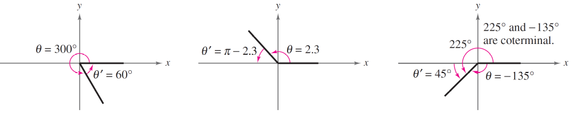
Example 4 – Solution
cont’d
Figure 4.38 shows each angle θ and its reference angle θ ′.
(a)
(b)
(c)
Figure 4.38

Slide 16
Trigonometric Functions of Real Numbers

Slide 17
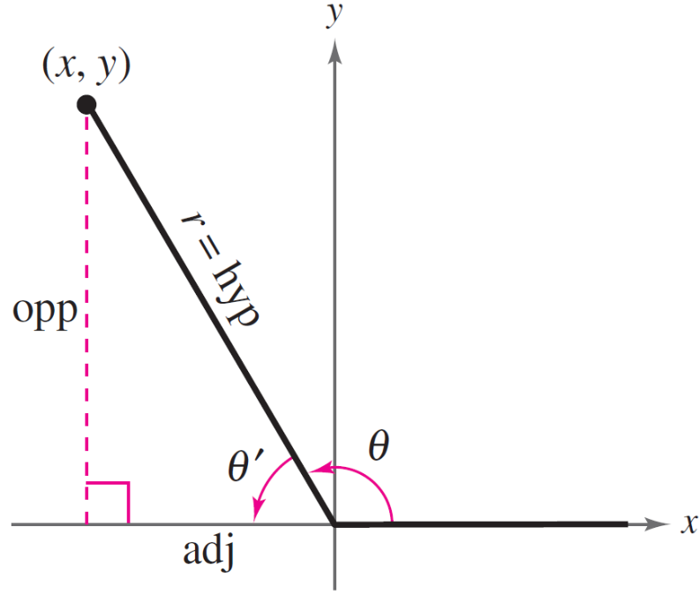
Trigonometric Functions of Real Numbers
To see how a reference angle is used to evaluate a trigonometric function, consider the point (x, y) on the terminal side of θ, as shown in Figure 4.39.
Figure 4.39

Slide 18
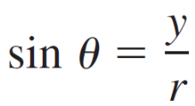
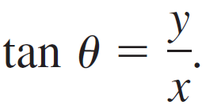
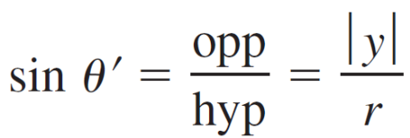
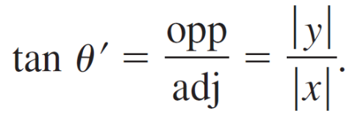
Trigonometric Functions of Real Numbers
By definition, you know that
and
For the right triangle with acute angle θ ′ and sides of lengths | x | and | y |, you have
and

Slide 19
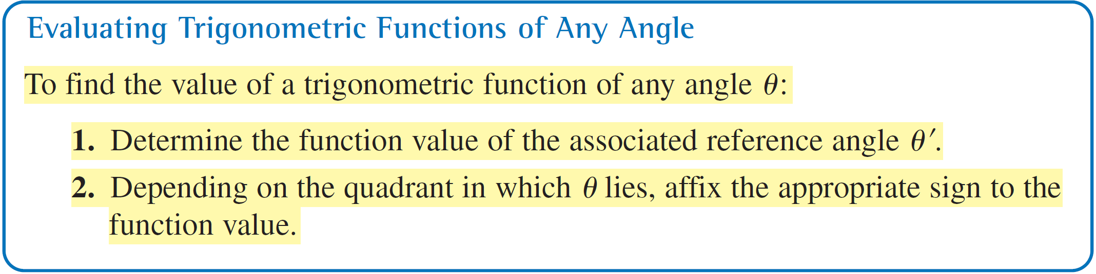
Trigonometric Functions of Real Numbers
So, it follows that sin θ and sin θ ′ are equal, except possibly in sign. The same is true for tan θ and tan θ ′ and for the other four trigonometric functions. In all cases, the sign of the function value can be determined by the quadrant in which θ lies.

Slide 20
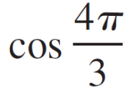
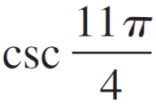
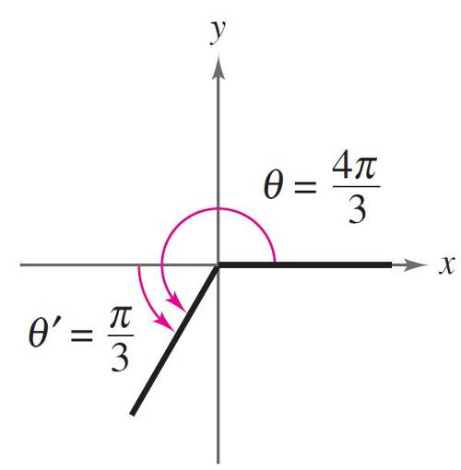
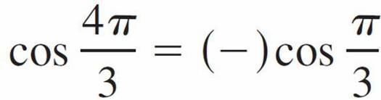
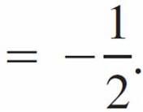
Example 5 – Trigonometric Functions of Nonacute Angles
Evaluate each trigonometric function.
a. b. tan = (–210 °) c.
Solution:
a. Because θ = 4π /3 lies in Quadrant III, the
reference angle is θ ′ = (4π /3) – π = π /3,
as shown in Figure 4.40.
Moreover, the cosine is negative in
Quadrant III, so
Figure 4.40

Slide 21
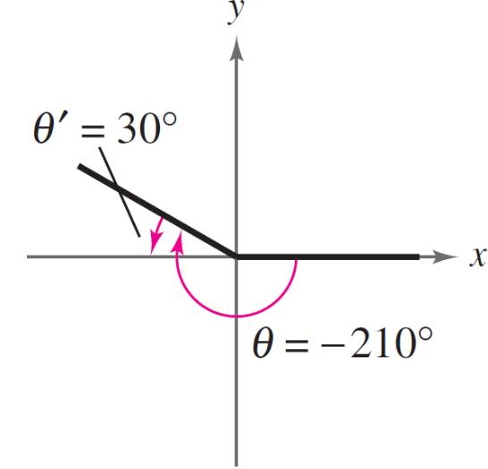
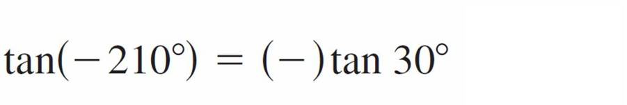
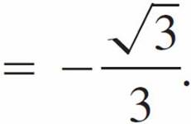
Example 5 – Solution
cont’d
b. Because –210 ° + 360 ° = 150 °, it follows that –210 ° is
coterminal with the second-quadrant angle 150 °.
Therefore, the reference angle is θ ′ = 180 ° – 150 ° = 30 °,
as shown in Figure 4.41.
Finally, because the tangent is
negative in Quadrant II, you have.
Figure 4.41

Slide 22
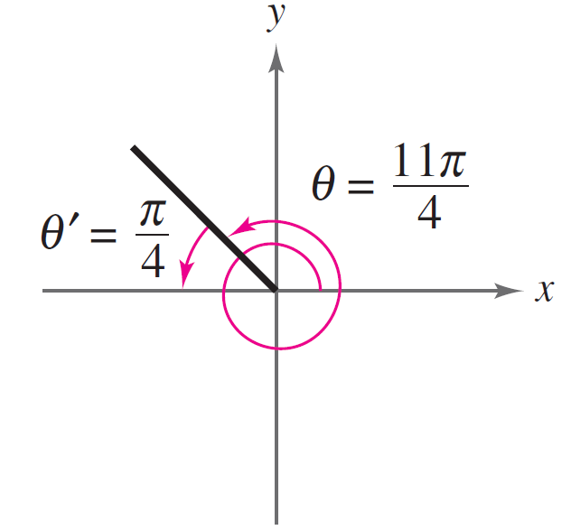
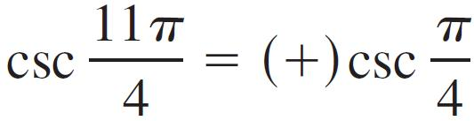
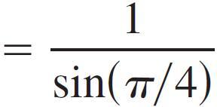

Example 5 – Solution
cont’d
c. Because (11π /4) – 2π = 3π /4, it follows that 11π /4 is
coterminal with the second-quadrant angle 3π/4.
Therefore, the reference angle is θ ′ = π – (3π /4) = π /4,
as shown in Figure 4.42.
Because the cosecant is positive
in Quadrant II, you have
Figure 4.42

